Slide 1
Do You Read Me?
Radio Waves, Magnetism, and Information Transfer
Version 2.0

Slide 2
GOALS FOR THIS LESSON:
Be able to define, describe and draw magnetic field lines around a single magnet
Describe the interaction between like and unlike magnetic poles
Be able to understand waves in various forms
Understand how radio waves are used to transmit information
ACTIVITIES:
How Magnets Work
Radio Waves
Morse Code
Version 2.0

Slide 3
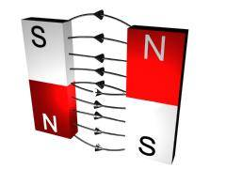
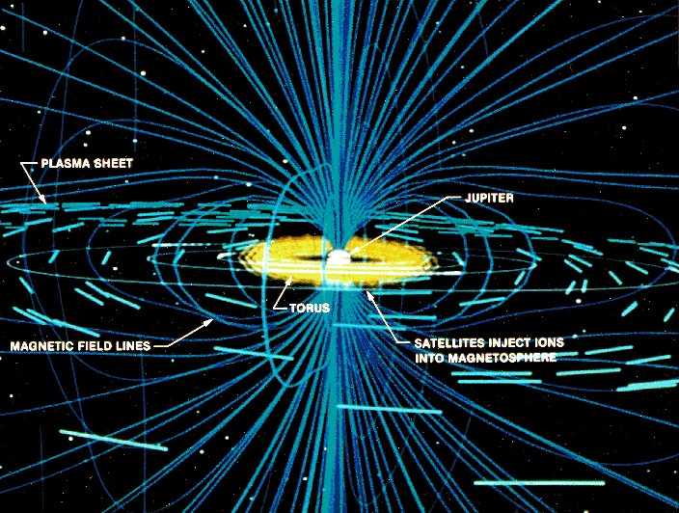
How do magnets work?
Let’s watch this video
(Click Above for link)
This Photo by Unknown Author is licensed under CC BY-SA
This Photo by Unknown Author is licensed under CC BY-SA
Version 2.0

Slide 4
Magnetic Fields: Recap of the Video
Let’s explore how magnets work
So what is a Magnetic Field?
Why is this important to us here on Earth?
Where can we go to see Aurora Borealis?
What kinds of research on magnetism and space could impact our future?
This Photo by Unknown Author is licensed under CC BY-NC-SA
[POTENTIAL BREAKPOINT FOR CLASS SESSION DEPENDING ON THE LENGTH OF YOUR CLASSROOM PERIOD]
Version 2.0

Slide 5
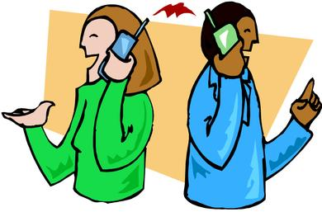
Radio Waves and Information Transfer: Can you hear me now?
This Photo by Unknown Author is licensed under CC BY-SA
This Photo by Unknown Author is licensed under CC BY-SA
Version 2.0

Slide 6
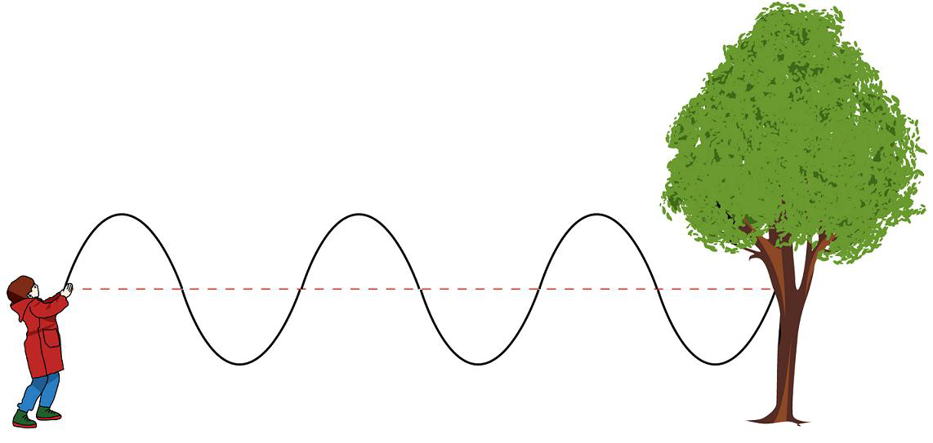
Inquiry: What is a radio wave? What is a megahertz? What is amplitude? What is frequency when discussing radio waves? - Yes, jump ropes can help us understand how radio waves move.
Version 2.0
This Photo by Unknown Author is licensed under CC BY-SA

Slide 7
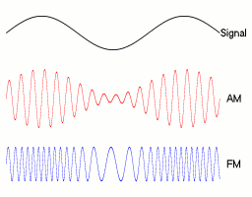
Information Transfer: how is information carried on these radio waves?
This Photo by Unknown Author is licensed under CC BY-SA
This Photo by Unknown Author is licensed under CC BY-SA
[POTENTIAL BREAKPOINT FOR CLASS SESSION DEPENDING ON THE LENGTH OF YOUR CLASSROOM PERIOD]
Version 2.0

Slide 8
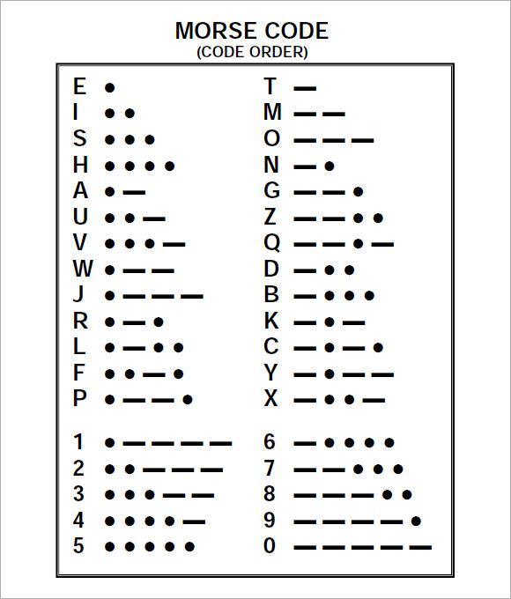
Morse Code:
an early means of electronic communication
www.education.com/activity/article/Morse_Code/
Version 2.0

Slide 9
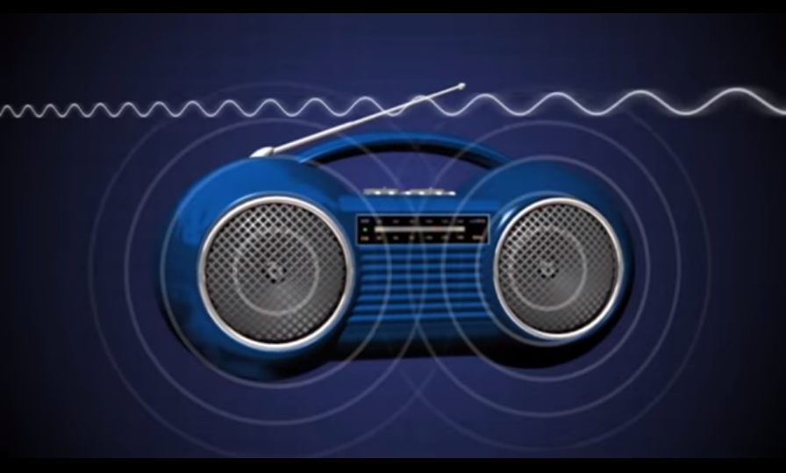
Radio Waves -
Click this link for video
Version 2.0

