Slide 1
Are We There Yet?!
Mapping It Out with Longitude and Latitude
Version 1.0

Slide 2
GOALS FOR TODAY:
Be able to define Longitude and Latitude. Explain the use of degrees, minutes, and seconds in the measurement of the Earth and positions on its surface
Be able to find locations on a map
Calculate the time and distance from your current location to Disney World
Version 1.0

Slide 3
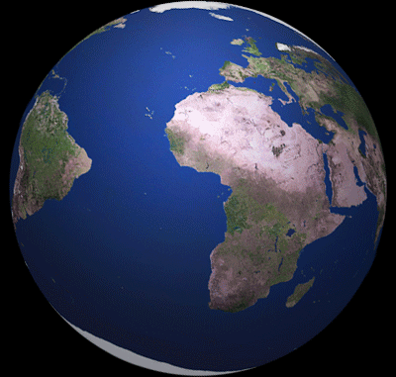
The Earth is Round and Spins on a tilted axis...
- It is nearly spherical and its surface is very irregular
- It takes approximately 24 hours to complete each rotation (1 day)
Let’s explore and fly around the earth together in Google Earth ® :
https://www.google.com/earth/
This Photo by Unknown Author is licensed under CC BY-NC-SA
Version 1.0

Slide 4
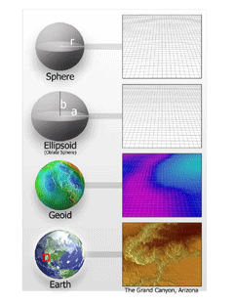
-It is Nearly Impossible to measure the surface of the Earth due to the irregularities such as mountains or valleys; and the rise and fall of the ocean tides -To compensate, scientists use theoretical models: Geoids and Ellipsoids
GEOID & ELLIPSOIDS:
The Earth is an imperfect sphere
Let’s do an exercise...
Punching out the globe!
[POTENTIAL BREAKPOINT FOR CLASS SESSION AFTER THE EXERCISE]
Version 1.0

Slide 5
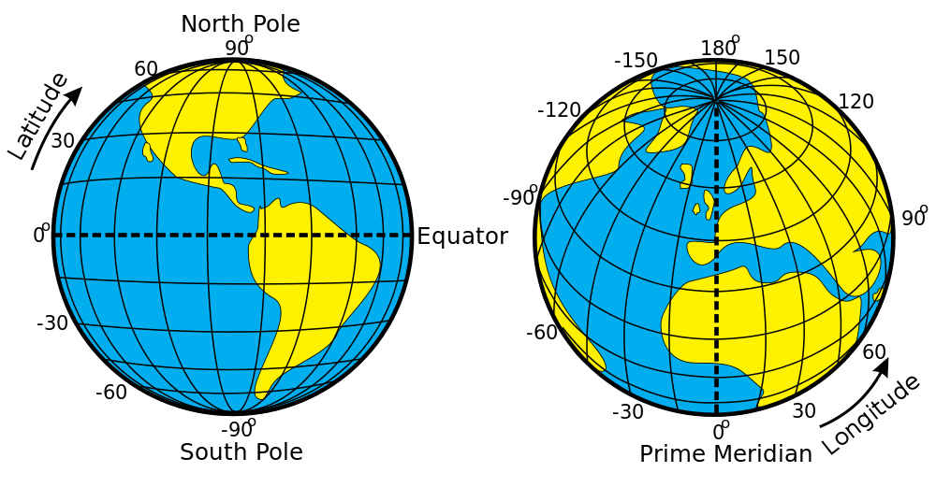
To determine the location of the places on Earth, we measure the East-West and North-South locations of the Earth. We do this by dividing the Earth by imaginary lines called “Latitude” and “Longitude”
-If we were to imagine that
these lines were points on a
graph, then the lines of
Latitude would be the X-axis
and the Longitudinal lines
would be the Y-axis
A system to describe location on the Earth
Version 1.0
Notes:
Reference (Pictures):
Latitude and Longitude: https://commons.wikimedia.org/wiki/File:Latitude_and_Longitude_of_the_Earth.svg

Slide 6
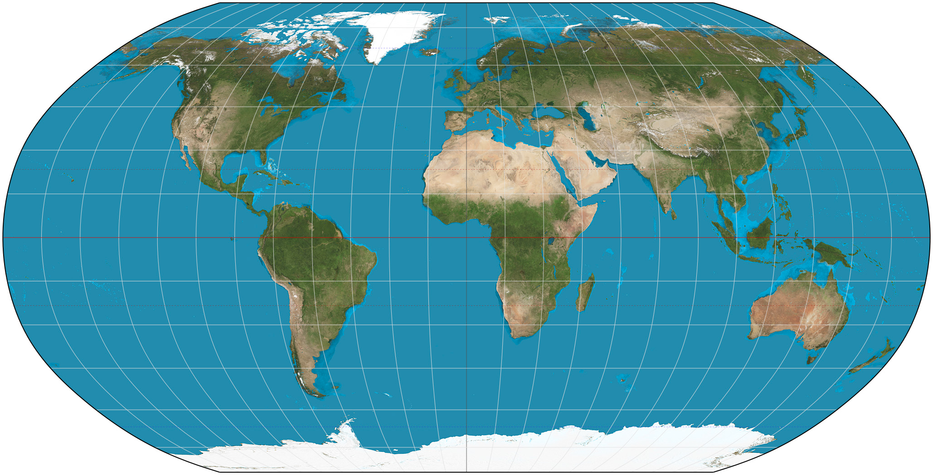
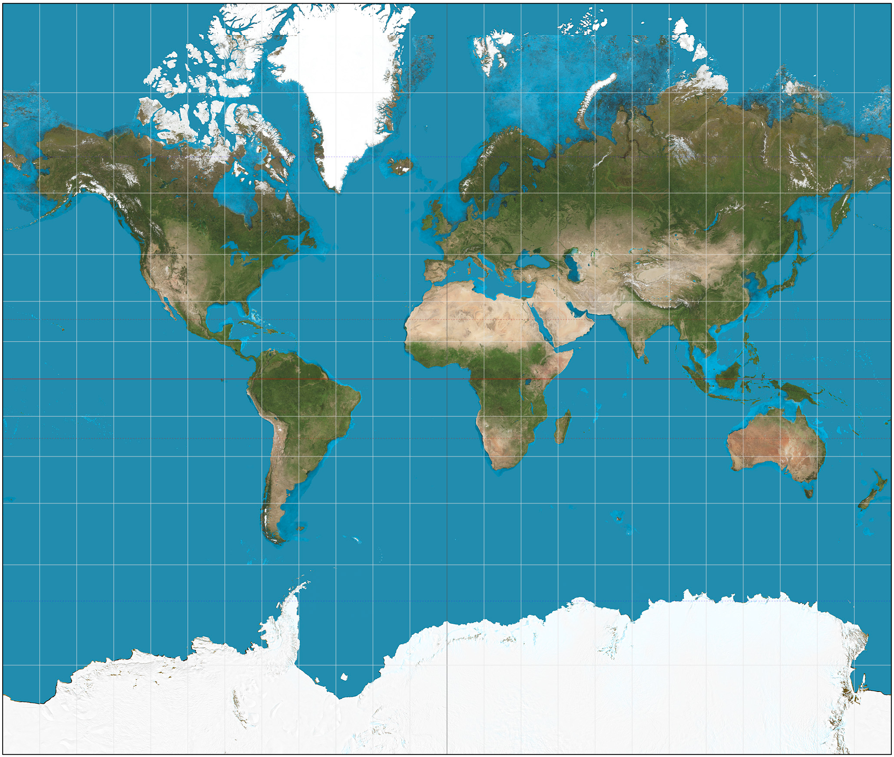
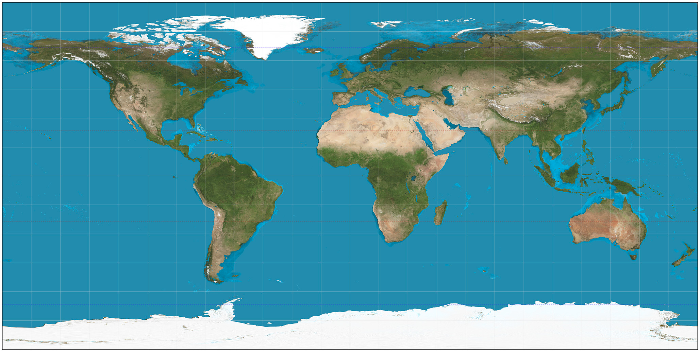
Distortions of the Earth
Which map is right?
Is Greenland bigger than the USA?
What is causing the distortion?
Which is the most accurate for shape?
Which is the most accurate for distance?
ROBINSON
MERCATOR
PLATE CARREE
Version 1.0
Notes:
References:
Mercator: https://en.wikipedia.org/wiki/Mercator_projection
Robinson: https://en.wikipedia.org/wiki/Robinson_projection
Plate Carree: https://en.wikipedia.org/wiki/Equirectangular_projection

Slide 7
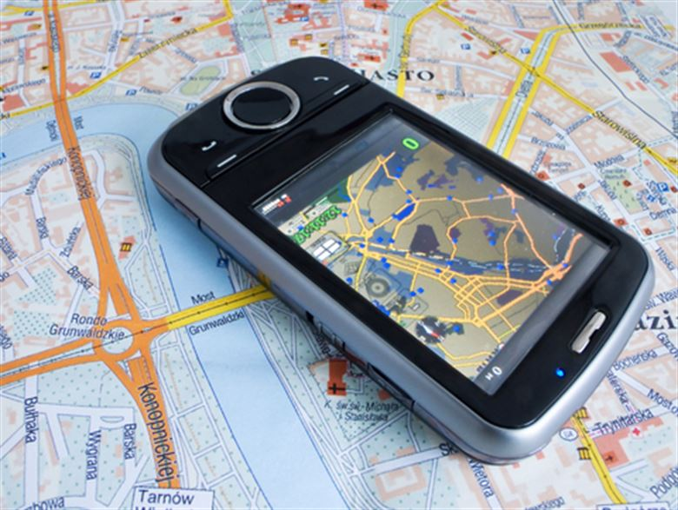
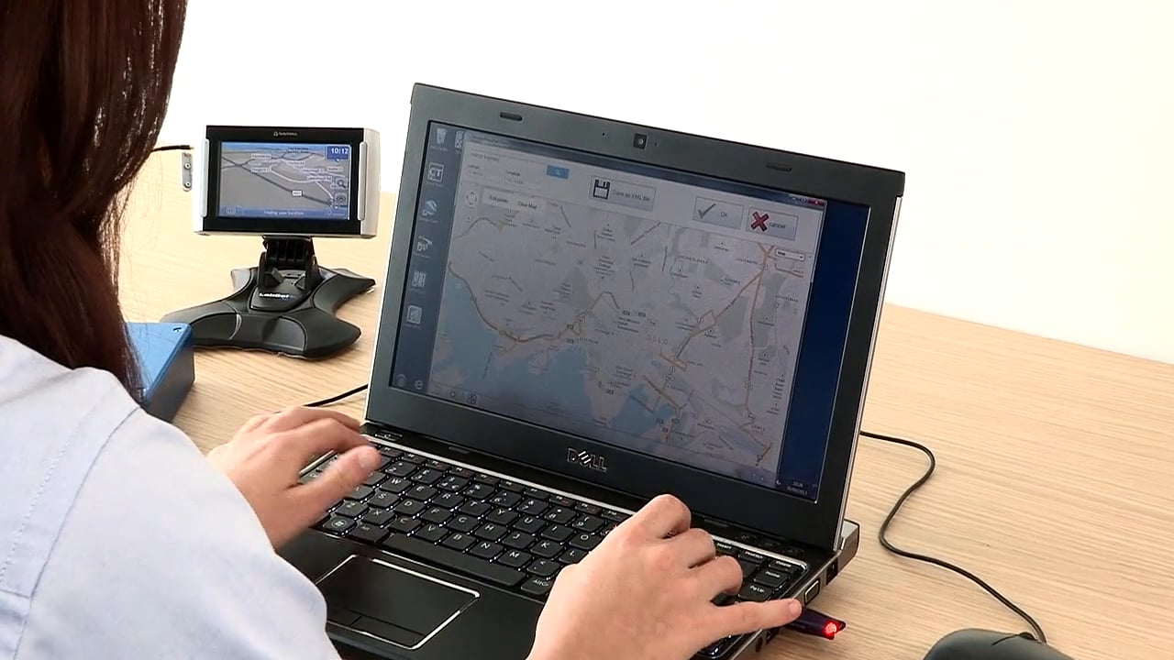
How do we find our location?
Complete your worksheets using one of the three following tools:
Atlas
Maps on
Mobile
Google Earth on PC
Version 1.0
Notes:
Picture References:
Atlas: https://pixabay.com/en/map-atlas-book-sheets-pages-2572025/
Maps on Mobile: http://www.grandforks.af.mil/News/Article/227510/is-your-information-safe-on-your-smart-phone/
Google Earth on PC: http://shroomery.org/forums/showflat.php/number/21178977

Slide 8
Get 3 classmates and plan a trip from here to
Orlando, FL...you’re going to Disney World! To plan your trip, what will your team
need to determine?
What are your Longitude and Latitude right now?
What are the Longitude and Latitude of Orlando, Fl?
How long will you drive before taking a break? Where will that be?
Using your map and a ruler, calculate the number of miles that you will need to drive to get to Orlando
Given that Distance = Time x Speed, how long will it take to drive there if you travel an average of 60 miles per hour when driving (remember your breaks!)?
Are We There Yet?!
Version 1.0
Notes:
References:
Disney World: https://www.travelchannel.com/interests/amusement-parks/articles/disney-world-in-a-wheelchair

Slide 9
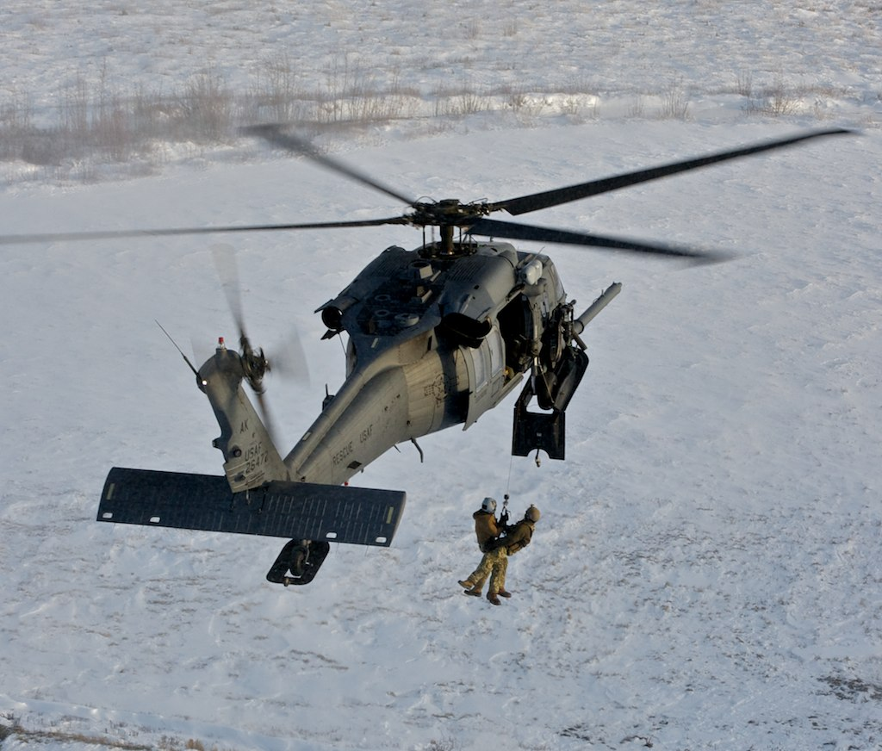
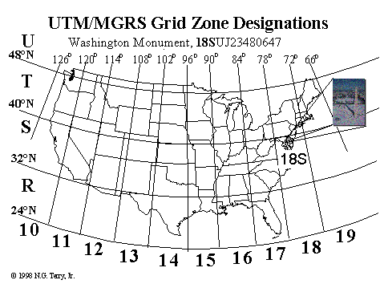
Calculating locations without an electronic tool can often seem complicated given the shape of the Earth and distortions that must be considered
The National Geospatial- Intelligence Agency (NGA) has developed a universal location language and presentation method that they call the US National Grid, (USNG)
Provides a standardized grid reference system that is seamless across jurisdictional boundaries and
Allows for pinpointing exact locations for cross-border missions such as Search and Rescue (see top image)
USNG improves public safety, commerce and aids the casual
GPS user with an easy to use geoaddress system for identifying
and determining location
See US National Grid Video
Optional Information:
The US National Grid!
Version 1.0
Notes:
Picture References:
Search and Rescue: http://www.af.mil/News/Article-Display/Article/109424/guard-rescue-center-completes-5000th-mission/
US Nagional Grid (Lower): https://www.fgdc.gov/usng/how-to-read-usng/index_html

