Slide 1
U.S. Space Based PNT Policy
Civil GPS Service Interface Committee
U.S. States and Local Government Subcommittee
Charleston, West Virginia
April 14, 2010
Maureen Walker
National Space Based PNT Coordination Office

Slide 2
Overview
U.S. Space-Based PNT Policy
GPS & Augmentation Programs Status
International Cooperation Activities

Slide 3



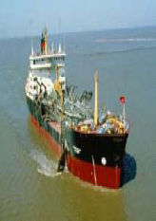
Areas for Cooperation
Multi-modal
Air
Maritime

Slide 4
U.S. Space-Based PNT Policy
GOAL: Ensure the U.S. maintains space-based PNT services, augmentation, back-up, and service denial capabilities that…
Provide uninterrupted availability of PNT services
Meet growing national, homeland, economic security, and civil requirements, and scientific and commercial demands
Remain the pre-eminent military space-based PNT service
Continue to provide civil services that exceed or are competitive with foreign civil space-based PNT services and augmentation systems
Remain essential components of internationally accepted PNT services
Promote U.S. technological leadership in applications involving space-based PNT services
4
Notes:
4

Slide 5
U.S. Space-Based PNT
Organization Structure
WHITE HOUSE
Defense
Transportation
NATIONAL
EXECUTIVE COMMITTEE
FOR SPACE-BASED PNT
Executive Steering Group
Co-Chairs: Defense, Transportation
State
ADVISORY
BOARD
Sponsor: NASA
Interior
Agriculture
Commerce
Homeland Security
NATIONAL
COORDINATION OFFICE
Host: Commerce
Joint Chiefs of Staff
NASA
GPS International
Working Group
Chair: State
Engineering Forum
Co-Chairs: Defense,
Transportation
Ad Hoc
Working Groups

Slide 6
U.S. Policy Promotes
Global Use of GPS Technology
No direct user fees for civil GPS services
  Provided on a continuous, worldwide basis
Open, public signal structures for all civil services
  Promotes equal access for user equipment manufacturing, applications development, and value-added services
  Encourages open, market-driven competition
Global compatibility and interoperability with GPS
Service improvements for civil, commercial, and scientific users worldwide
Protection of radionavigation spectrum from disruption and interference

Slide 7
Overview
U.S. Space-Based PNT Policy
GPS & Augmentation Programs Status
International Cooperation Activities

Slide 8
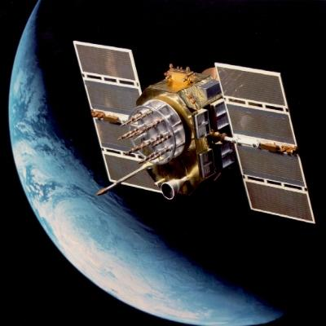

GPS Constellation Status
30 Operational Satellites
(Baseline Constellation: 24)
11 Block IIA
12 Block IIR
7 Block IIR-M
  Transmitting new second civil signal
  1 GPS IIR-M in on-orbit testing
3 additional satellites in residual status
  Next launch: IIF ~ June 2010
Global GPS civil service performance commitment met continuously since December 1993

Slide 9
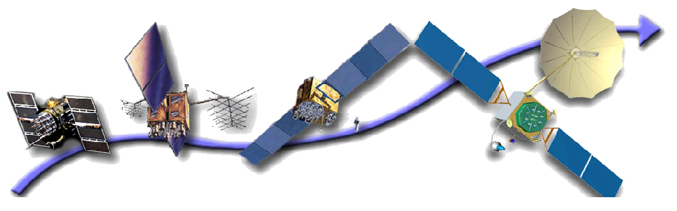
GPS Modernization Program
Increasing System Capabilities w Increasing Defense / Civil Benefit
Block IIA/IIR
Block IIR-M, IIF
Block III
Basic GPS
Standard Service
  Single frequency (L1)
  Coarse acquisition (C/A) code navigation
Precise Service
  Y-Code (L1Y & L2Y)
  Y-Code navigation
IIR-M: IIA/IIR capabilities plus
2nd civil signal (L2C)
M-Code (L1M & L2M)
IIF: IIR-M capability plus
3rd civil signal (L5)
Anti-jam flex power
Backward compatibility
4th civil signal (L1C)
Increased accuracy
Increased anti-jam power
Assured availability
Navigation surety
Controlled integrity
Increased security
System survivability

Slide 10
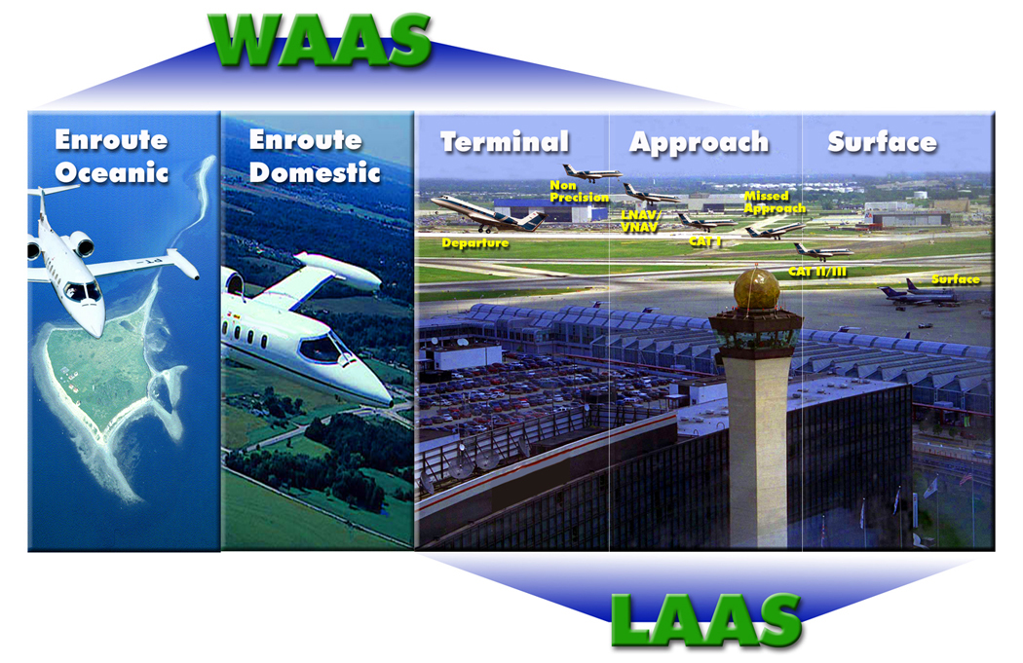
FAA GPS Augmentation Programs

Slide 11
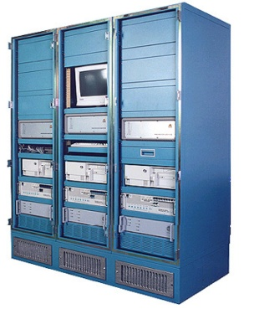
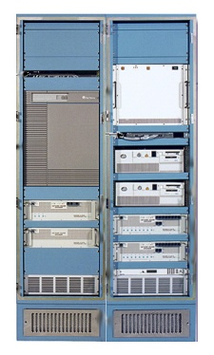
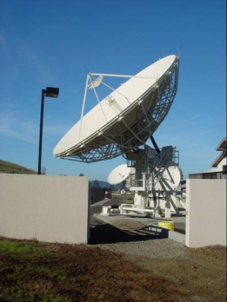
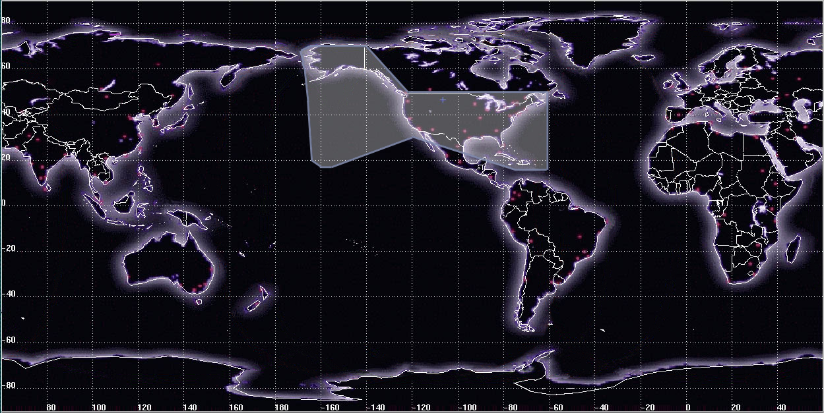
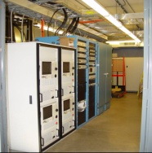
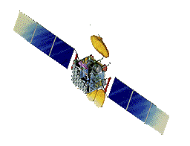
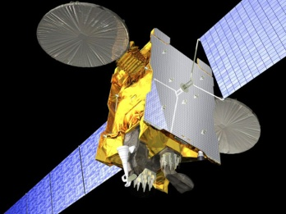
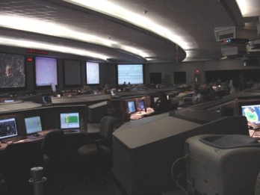
WAAS Architecture
38 Reference
Stations
3 Master
Stations
4 Ground
Earth Stations
Intelsat
133°W
Telesat
107°W
4F3
98° W
(2+1) Geostationary
Satellite Links
2 Operational
Control Centers
Notes:
The Wide Area Augmentation System (WAAS) is one of 4 Space Based Augmentation Systems (SBAS) in operation or in development around the globe. The Japanese MSAS, and Indian GAGAN systems are similar to the U.S. WAAS, and the EU has the EGNOS system.
The WAAS configuration consists of 38 Wide Area Reference Stations (WRS) feeding data to 3 Wide Area Master Stations (WMS), that compute GPS corrections and integrity information which is forwarded to four geographically dispersed Ground Earth Stations (GES), and uplinked as messages to two geostationary earth orbiting (GEO) satellites and broadcast to the users. The system is controlled from two Operational Control Centers (OCC), one located at the National Operational Command Center (NOCC) in Herndon, VA and the second located at the Pacific Operational Control Center (POCC) in San Diego, CA. A third GEO is being added to meet availability and continuty requirements.

Slide 12
Global SBAS Coverage

Slide 13
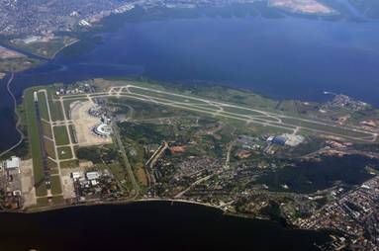
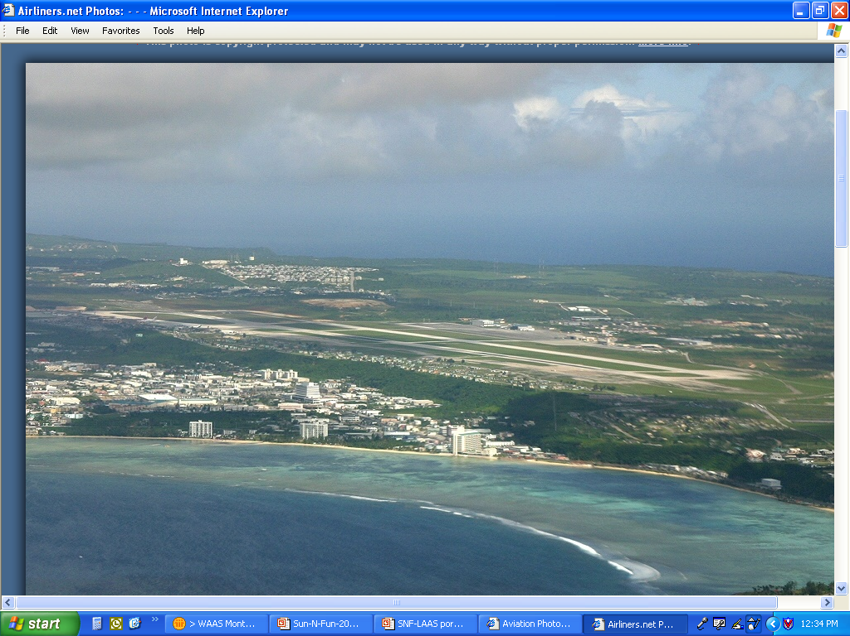
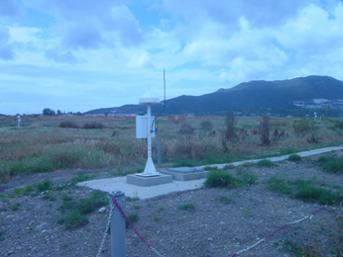
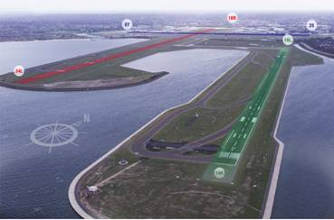
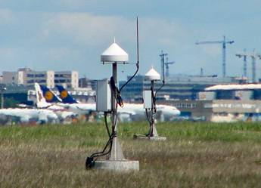
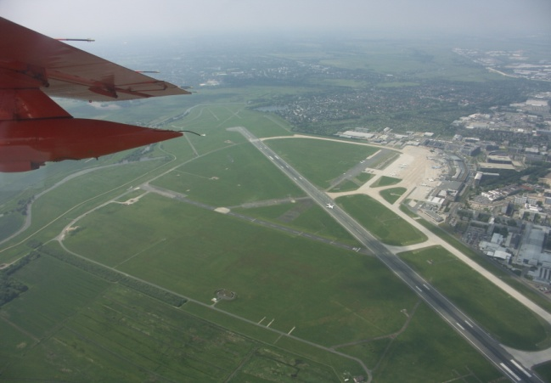
LAAS/GBAS International Efforts
Rio De Janeiro, Brazil
Agana, Guam
Malaga, Spain
Sydney, Australia
Frankfurt, Germany
Bremen, Germany
Notes:
There are several Category-I LAAS prototypes installed at locations around the world. The Category-I system design approval at Memphis is expected to facilitate similar approvals for LAAS systems in Australia, Germany, and Spain. The SDA approval at Memphis was achieved as a result of international cooperation between Airservices Australia, and the FAA.

Slide 14
Overview
U.S. Space-Based PNT Policy
GPS & Augmentation Programs Status
International Cooperation Activities
14

Slide 15
Planned GNSS
Global Constellations
  GPS (24+)
  GLONASS (30)
  Galileo (27+3)
  Compass (30 global and 5 regional satellites)
  GINS - Global Indian Navigation System (24)
Regional Constellations
  QZSS (3)
  IRNSS (7)
Satellite-Based Augmentations
  WAAS (2+1)
  MSAS (2)
  EGNOS (3)
  GAGAN (2)
  SDCM (2)

Slide 16
U.S. Objectives in Working with Other GNSS Service Providers
Ensure compatibility ― ability of U.S. and non-U.S. space-based PNT services to be used separately or together without interfering with each individual service or signal
  Radio frequency compatibility
  Spectral separation between M-code and other signals
Achieve interoperability – ability of civil U.S. and non-U.S. space-based PNT services to be used together to provide the user better capabilities than would be achieved by relying solely on one service or signal
  Primary focus on the common L1C and L5 signals
Ensure a level playing field in the global marketplace
Pursue through Bi-lateral and
Multi-lateral Cooperation

Slide 17
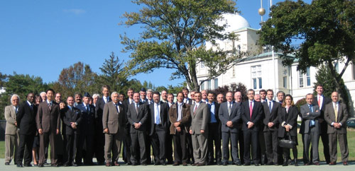
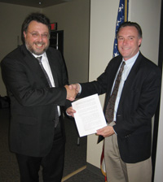
U.S. - Europe Cooperation
2004 U.S.-EU agreement provides foundation for cooperation
Four working groups were set up under the agreement:
  Technical, trade, next generation systems and security working groups
Improved new civil signal (MBOC) adopted in July 2007
Second Plenary Meeting April 19-22, 2010 in Brussels
Signing ceremony for GPS-Galileo Cooperation Joint Statement, Oct. 23, 2008
(Michel Bosco, European Commission;
Kenneth Hodgkins, U.S. Department of State)
Oct. 22, 2008 , EU-U.S. Plenary delegations meeting under the auspices of the GPS-Galileo Cooperation Agreement

Slide 18
Additional Bilateral Cooperation
U.S.-Japan Joint Statement on GPS Cooperation in 1998
  Japan’s Quasi Zenith Satellite System (QZSS) designed to be fully compatible and highly interoperable with GPS
  Bilateral agreements to set up QZSS monitoring stations in Hawaii and Guam. Guam station completed!
U.S.-Russia Joint Statement issued in Dec. 2004
  Negotiations for a U.S.-Russia Agreement on satellite navigation cooperation underway since late 2005
  Working Groups on compatibility/interoperability, search and rescue
U.S.-India Joint Statement on GNSS Coop. in 2007
  Technical Meetings focused on GPS-India Regional Navigation Satellite System (IRNSS) compatibility and interoperability held in 2008 and 2009
18
Notes:
03/12/08
18

Slide 19
International Committee on GNSS (ICG)
& Providers Forum
ICG purpose:
  Promote the use of GNSS and its integration into infrastructures, particularly in developing countries
  Encourage compatibility and interoperability among global and regional systems
Members include: GNSS providers (U.S., EU, Russia, China, India, Japan), international organizations, and international associations
U.S. hosted ICG-3 at NASA JPL/Cal Tech in Pasadena, Dec. 8-12, 2008
Russia hosted ICG-4 at St. Petersburg, Sep. 14-18, 2009
                Associated Providers Forum enables focused discussions on compatibility and interoperability, encouraging development of systems complimenting GPS
                ICG-5 to be held in October 2010 in Turin, Italy

Slide 20
APEC
GNSS Implementation Team (GIT)
Promote implementation of regional GNSS augmentation systems to enhance inter-modal transportation and recommend actions to be considered in the Asia Pacific Region
Reports to Transportation Working Group (TPT-WG) through the Inter-modal Experts Group (IEG)
Terms of Reference:
  Facilitate GNSS applications to support seamless intermodal transportation to enhance safety, security, and sustainability.
  Identify actions to facilitate and collaborate on implementation of GNSS applications for transportation in the APEC region, complementing the work of international organizations.
  Provide a public/industry forum to address GNSS technologies related to transportation issues that will benefit the APEC region.

Slide 21
APEC (Continued)
US to host 14th Meeting of the GNSS Team
June 21-24, 2010 in Seattle, Washington
Need for greater involvement of U.S. agencies and U.S. industry in APEC deliberations concerning GNSS technologies and implementation
• Need to identify areas where GNSS could enhance the drive for greater GNSS interoperability and compatibility in the transport sector
• Anticipate an industry round table as part of the Meeting;
also welcoming non-government organizations, such as IGS, FIG and IAG
• Seeking opportunities to use GNSS technology to increase energy efficiency, reduce congestion and enhance infrastructure

Slide 22
Summary
GPS performance is better than ever and will continue to improve
  Augmentations enable even higher performance
  New civil GPS signal available now
  Many additional upgrades scheduled
U.S. policy encourages worldwide use of civil GPS and augmentations
International cooperation is a priority
  Compatibility and interoperability very important

Slide 23
Maureen Walker
Senior State Department Representative
to the
National Space-based Positioning, Navigation and Timing Coordination Office
202-482-5809 (office)
Maureen.walker@pnt.gov
pnt.gov
gps.gov

