Slide 1
ADVANCEMENTS in GPS & AERIAL PHOTOGRAPHY
DeLane R. Meier PE/LS
Surveys & Photogrammetry
GIS Intermountain Conference Meeting
Bozeman, MT
April, 2010

Slide 2
We surveyed in all types of weather, riding on an ATV & UTV … or

Slide 3
… walking

Slide 4
We surveyed in all types of terrain

Slide 5
Horizontal & Vertical monuments were used in all of our surveys

Slide 6
ND 8 north of Stanley, ND

Slide 7
Surveying the hard way

Slide 8
How deep is the snow?

Slide 9
What do they see?
Lets go see!
There goes the SkyMaster.
I wonder what the NDDOT is up to today ?

Slide 10
SkyMaster airplane with Digital Aerial Camera

Slide 11
DMC in the airplane

Slide 12
Cameraman using the Display

Slide 13
Bottom of the Camera

Slide 14
Processing in the office
That’s cool. What do they do with the Digital data?

Slide 15
Digital Image Processer Station

Slide 16
SSK Stereoplotter

Slide 17
NDGPS and Non-control
How does NDGPS work with non-controlled photos?

Slide 18
Non-Controlled Mosaic

Slide 19
Controlled Mosaic

Slide 20
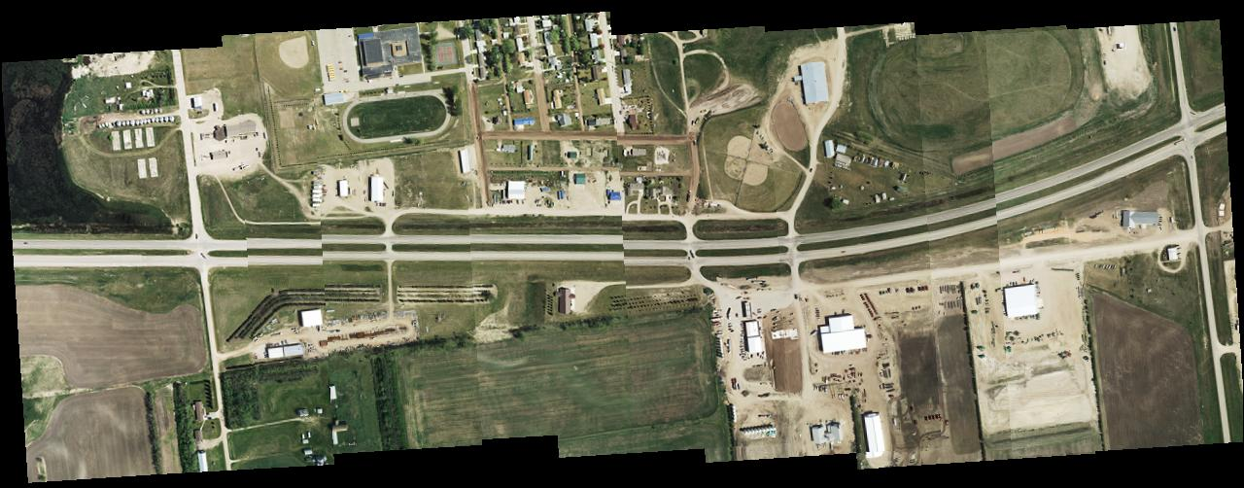
Before and after

Slide 21
McHenry CO. Mission flight lines

Slide 22
McHenry County Final product

Slide 23
NDGPS Network in North Dakota area

Slide 24
STATION MEDORA (the tower)

Slide 25
STATION MEDORA (the geodetic antenna)

Slide 26
STATION MEDORA (the GPS Receivers)

Slide 27
NDGPS SITES IN & NEAR ND

Slide 28
NDGPS & OPUS-RS

Slide 29
More Photos
Let’s follow them
Where are they going now?

Slide 30
Dead Trees!

Slide 31
Not everything is dead

Slide 32
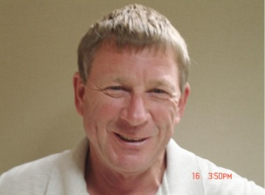
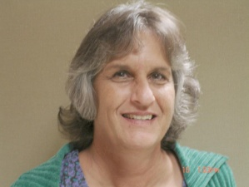
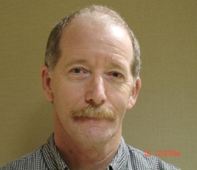
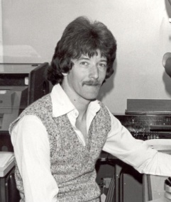
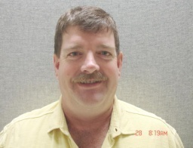
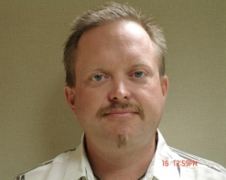
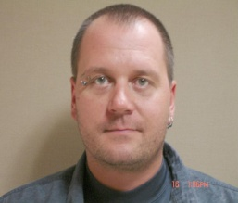
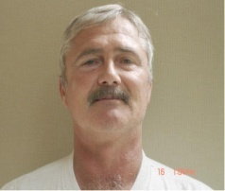
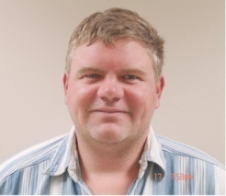
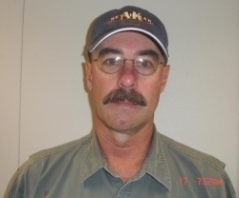
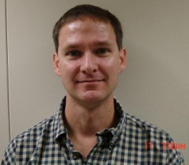
SPECIAL “THANK YOU” TO THE SURVEYS & PHOTOGRAMMETRY STAFF
SURVEYS
RIGHT OF WAY PLATS
PHOTOGRAMMETRY
Greg Lattimore, LS
Lou Ann Adams, LS
Paul Stubbs
Guess who?
Robert Zahn, LS
Adam Cahlin
Chad Hanson, LS
Troy Zornjak
Eric Atwood
Mike Lang
Will Patrick
Monte Obrigewitch

Slide 33
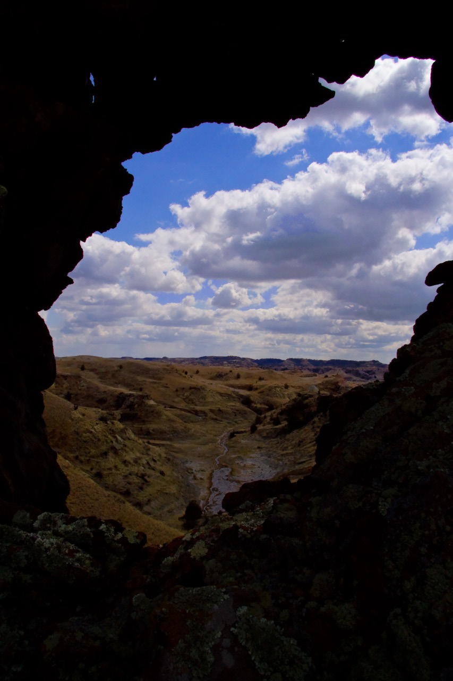
PLAY STANLEY NEXT
THE END

